Slide 1



FINAL PROJECT PRESENTATION
Employee Performance & Sales Analytics Dashboard
An Interactive Data Visualization Dashboard built using Employee Performance dataset
Presented by: Shivam Kawatra

Slide 2



What We’ll Cover
Agenda for today’s final project presentation
01
Introduction & Problem Statement
05
Visualizations & Chart Types
02
Project Objectives
06
Interactive Filters
03
Dataset Description
07
Expected Outcomes & Conclusion
04
Proposed Dashboard Features

Slide 3
Organizational Performance Insights
Comprehensive employee analytics across departments, roles, and locations
Employee data exhibits wide variations in salary structures, sales performance, bonus allocation, and ratings across various departments and office locations. Understanding these differences is essential for effective workforce management, fair compensation distribution, and strategic decision-making.
Multiple Departments
Diverse Locations
Performance Metrics
Sales Analytics
Organization diversity
Regional granularity
Rating & Compensation
Individual Contributions
Source: Employee Performance Dataset – synthesized figures for context

Slide 4
Problem Statement
Employee data is rich, but hard to analyze, interpret, and compare across departments
!
i
The Challenge Today
Our Approach
Employee data is buried in static spreadsheets
Difficult to track performance or compare departments
Hard to identify top performers and sales contributions
Manual data review delays smart management choices
Prepared and structured raw data using Excel
Built an interactive Tableau dashboard
Used KPI cards, bar charts, and treemaps for visual clarity
Added department and location filters for fast analysis

Slide 5
Project Objectives
What the dashboard is designed to achieve
1
Interactive Analytics — Build a dynamic Employee Performance & Sales Dashboard in Tableau.
2
Performance Insights — Analyze department-wise salary structures and overall sales performance.
3
Identify Key Talent — Spot top-performing employees based on sales and compensation metrics.
4
Visualizing Demographics — Map out employee distribution clearly across different departments.
5
Dynamic Exploration — Enable quick filtering by department and location for targeted decision-making.

Slide 6
Dataset Description
Employee Performance & Sales datasets powering the dashboard
“Employee Performance, Compensation, and Sales Analytics Dataset”
SOURCE
COVERAGE
FORMAT
Microsoft Excel / Raw Employee Records
Employee Performance & Department Level
Structured Tabular Data
The dataset offers a comprehensive overview of employee performance and sales outcomes capturing key metrics such as Employee ID, Name, Department, Location, Salary, Performance Rating, Bonus Percentage, Total Compensation, and Total Sales across different organization levels.

Slide 7
Dataset Variables
Key fields captured for every employee across departments and locations
Employee ID & Name
Department
Location
Salary
Bonus Percentage
Total Compensation
Performance Rating
Total Sales
Employee Attributes

Slide 8
Dashboard Feature: KPI Cards
At-a-glance summary metrics shown at the top of the dashboard
Total Employees
Total Sales
Average Salary
Average Rating
Average Compensation
Each KPI card surfaces a single headline number, refreshed instantly as filters change.

Slide 9
Dashboard Features: Bar Charts & Visuals
Comparative and distributional views of employee performance and sales data
Bar Charts
Bar Chart Features
Visual Comparison of key metrics across organizational groups, making department and location trends instantly clear.
Compare baseline pay across different teams
Track regional sales performance across office locations
Highlight highest sales performing individual contributions

Slide 10
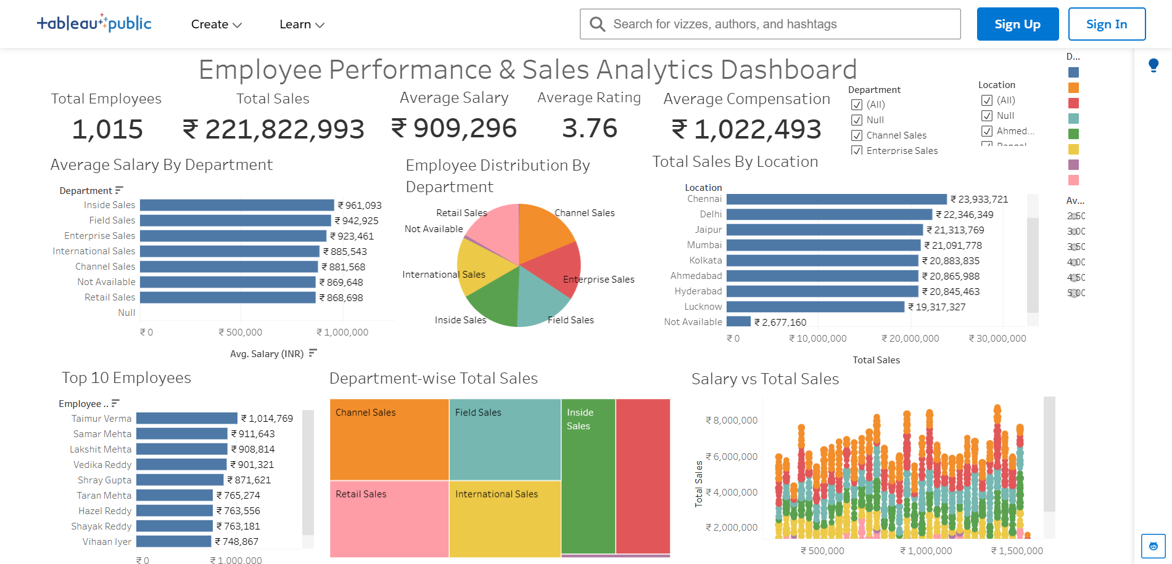
Live Dashboard Demonstration
Interactive data visualization dashboard built using Employee Performance dataset
Link
https://public.tableau.com/app/profile/shivam.kawatra/viz/EmployeeAnalytics_17845026121930/EmployeePerformanceSalesAnalyticsDashboard?publish=yes

